Slide 1
Developing an NLP Model to Identify Depression and Suicidal Ideation in Online Posts
Our project aimed at building an NLP model to accurately detect online posts related to depression and suicide, to assist mental health organizations and governments in identifying and providing timely support to individuals expressing suicidal ideation.

Slide 2

The Team
Esther Nyokabi
Joel Lenkinyei
Tipape
Jane Kinuthia
Karura
Muthoni
Keith
Eugene
Ochieng

Slide 3

Problem Statement
Social media has become a platform for individuals to express suicidal ideation, posing a challenge to mental health professionals worldwide.
Identifying such posts online is difficult, particularly for governments and mental health organizations.

Slide 4

Research Questions
Can machine learning algorithms accurately detect posts with suicidal ideation?
What are the most important features or patterns in language that predict suicidal ideation in online forums?
Are there differences in language patterns between individuals who express suicidal ideation versus those who do not?
Can the developed classifier be generalized to identify suicidal ideation in other social media platforms?
What ethical considerations should be taken into account when using machine learning to analyze language related to suicide ideation in online forums?
Can deep learning models such as CNNs and RNNs improve the accuracy of the text classifier?

Slide 5

Data Processing
The dataset consisted of 232,074 posts, evenly split between "suicide" and "non-suicide" classes.
The data underwent text cleaning and tokenization to prepare it for modeling.
Text was further enhanced by lemmatizing words and removing stop words to improve data quality for model development

Slide 6
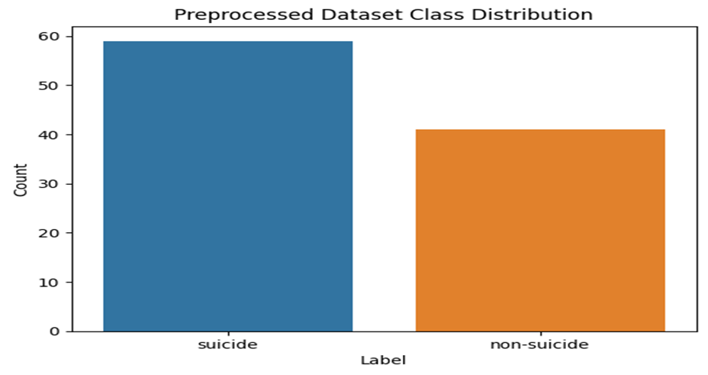
Data Exploration
Conducted visual and statistical analysis to explore the dataset.

Slide 7

Modelling & Evaluation
The dataset was split into training (80%) and testing (20%) sets.
RNN model achieved 80% accuracy and 0.53 test loss, accurately detects suicidal ideation posts
SVM model had 75% accuracy, better precision for "suicide" than "non-suicide"
F1-score for "non-suicide" was 0.62 and for "suicide" was 0.81, with weighted average F1-score of 0.76 for SVM

Slide 8

Findings & Conclusion
NLP can accurately identify suicidal ideation posts
SVM and RNN models show potential for detecting suicidal ideation in online forums
Further research needed to improve their performance, especially for non-suicidal posts
More exploration needed to identify key language patterns predicting suicidal ideation
Ethical considerations (privacy, consent, responsible use) when using ML to analyze suicide ideation language
Models can assist mental health professionals in identifying at-risk individuals in online forums
Models should not replace mental health professionals, but aid in identifying individuals at risk for suicide.

Slide 9
